Slide 1
Chapter 5
Exception Handling and Multithreading in Python

Slide 2
Exception Handling
Error in Python can be of two types i.e. Syntax errors and Exceptions.
Errors - are the problems in a program due to which the program will stop the execution.
On the other hand, exceptions - are raised when some internal events occur which changes the normal flow of the program.
The difference between Syntax Error and Exceptions
Syntax Error: As the name suggest this error is caused by wrong syntax in the code.
It leads to the termination of the program.
Example
# initialize the amount variable
amount = 10000
# check that You are eligible to purchase Dsa Self Paced or not
if(amount>2999)
print("You are eligible to purchase Dsa Self Paced")
Output
It returns a syntax error message because after if statement a colon : is missing.
We can fix this by writing the correct syntax.

Slide 3
Exceptions:
Exceptions are raised when the program is syntactically correct but the code resulted in an error.
This error does not stop the execution of the program, however, it changes the normal flow of the program.
Example:
# initialize the marks variable
marks = 10000
# perform division with 0
a = marks / 0
print(a)
Output:
In the above example raised the ZeroDivisionError as we are trying to divide a number by 0.
Note: Exception is the base class for all the exceptions in Python.

Slide 4
Some of the common Exception Errors are :
IOError : if the file can’t be opened
KeyboardInterrupt : when an unrequired key is pressed by the user
ValueError : when built-in function receives a wrong argument
EOFError : if End-Of-File is hit without reading any data
ImportError : if it is unable to find the module

Slide 5
Try - Except in Python
Try and Except statement is used to handle these errors within our code in Python.
The try block is used to check some code for errors i.e the code inside the try block will execute when there is no error in the program.
Whereas the code inside the except block will execute whenever the program encounters some error in the preceding try block.(Java uses catch keyword) Syntax:
try:
# Some Code
except:
# Executed if error in the
# try block
How try() works?
First, try clause is executed i.e. the code between try and except clause.
If there is no exception, then only try clause will run, except clause is finished.
If any exception occured, try clause will be skipped and except clause will run.
If any exception occurs, but the except clause within the code doesn’t handle it, it is passed on to the outer try statements.
If the exception left unhandled, then the execution stops.
A try statement can have more than one except clause

Slide 6
Code 1: No exception, so try clause will run.
# Python code to illustrate working of try()
def divide(x, y):
try:
# Floor Division : Gives only Fractional Part as Answer
result = x // y
print("Yeah ! Your answer is :", result)
except ZeroDivisionError:
print("Sorry ! You are dividing by zero ")
# Look at parameters and note the working of Program
divide(3, 2)
Output :
('Yeah ! Your answer is :', 1)

Slide 7
Code 1: There is an exception so only except clause will run.
# Python code to illustrate working of try()
def divide(x, y):
try:
# Floor Division : Gives only Fractional Part as Answer
result = x // y
print("Yeah ! Your answer is :", result)
except ZeroDivisionError:
print("Sorry ! You are dividing by zero ")
# Look at parameters and note the working of Program
divide(3, 0)
Output :
Sorry ! You are dividing by zero

Slide 8
Else Clause
In python, you can also use the else clause on the try-except block which must be present after all the except clauses.
The code enters the else block only if the try clause does not raise an exception.
Syntax:
try:
# Some Code
except:
# Executed if error in the
# try block
else:
# execute if no exception
Code:
# Program to depict else clause with try-except
# Function which returns a/b
def AbyB(a , b):
try:
c = ((a+b) / (a-b))

Slide 9
except ZeroDivisionError:
print "a/b result in 0"
else:
print c
# Driver program to test above function
AbyB(2.0, 3.0)
AbyB(3.0, 3.0)
Output:
-5.0a/b result in 0
Finally Keyword in Python
Python provides a keyword finally, which is always executed after try and except blocks.
The final block always executes after normal termination of try block or after try block terminates due to some exceptions.

Slide 10
Syntax:
try:
# Some Code
except:
# Executed if error in the
# try block
else:
# execute if no exception
finally:
# Some code .....(always executed)
# Python program to demonstrate finally
# No exception Exception raised in try block
try:
k = 5//0 # raises divide by zero exception.
print(k)
# handles zerodivision exception
except ZeroDivisionError:
print("Can't divide by zero")

Slide 11
finally:
# this block is always executed
# regardless of exception generation.
print('This is always executed')
Output:
Can't divide by zero
This is always executed
Some of the common
built-in exceptions are
other than above
mention
exceptions are:
Exception | Description
IndexError | When the wrong index of a list is retrieved.
AssertionError | It occurs when assert statement fails
AttributeError | It occurs when an attribute assignment is failed.
ImportError | It occurs when an imported module is not found.
KeyError | It occurs when the key of the dictionary is not found.
NameError | It occurs when the variable is not defined.
MemoryError | It occurs when a program run out of memory.
TypeError | It occurs when a function and operation is applied in an incorrect type.

Slide 12
Raising Exceptions in Python
In Python programming, exceptions are raised when errors occur at runtime.
We can also manually raise exceptions using the raise keyword.
We can optionally pass values to the exception to clarify why that exception was raised.
>>> raise KeyboardInterrupt
Traceback (most recent call last):
...
KeyboardInterrupt
>>> raise MemoryError("This is an argument")
Traceback (most recent call last):
...
MemoryError: This is an argument
>>> try:
... a = int(input("Enter a positive integer: "))
... if a <= 0:
... raise ValueError("That is not a positive number!")
... except ValueError as ve:
... print(ve)
Output
Enter a positive integer: -2
That is not a positive number!

Slide 13
Catching Exceptions in Python
In Python, exceptions can be handled using a try statement.
The critical operation which can raise an exception is placed inside the try clause.
The code that handles the exceptions is written in the except clause.
We can thus choose what operations to perform once we have caught the exception.
Here is a simple example.
# import module sys to get the type of exception
import sys
randomList = ['a', 0, 2]
for entry in randomList:
try:
print("The entry is", entry)
r = 1/int(entry)
break
except:
print("Oops!", sys.exc_info()[0], "occurred.")
print("Next entry.")
print()
print("The reciprocal of", entry, "is", r)

Slide 14
Output
The entry is a
Oops! <class 'ValueError'> occurred.
Next entry.
The entry is 0
Oops! <class 'ZeroDivisionError'> occured.
Next entry.
The entry is 2
The reciprocal of 2 is 0.5
In this program, we loop through the values of the randomList list.
As previously mentioned, the portion that can cause an exception is placed inside the try block.
If no exception occurs, the except block is skipped and normal flow continues(for last value). But if any exception occurs, it is caught by the except block (first and second values).
Here, we print the name of the exception using the exc_info() function inside sys module.
We can see that a causes ValueError and 0 causes ZeroDivisionError.

Slide 15
Since every exception in Python inherits from the base Exception class,
we can also perform the above task in the following way:
# import module sys to get the type of exception
import sys
randomList = ['a', 0, 2]
for entry in randomList:
try:
print("The entry is", entry)
r = 1/int(entry)
break
except Exception as e:
print("Oops!", e.__class__, "occurred.")
print("Next entry.")
print()
print("The reciprocal of", entry, "is", r)
This program has the same output as the above program.

Slide 16
Python try...finally
The try statement in Python can have an optional finally clause.
This clause is executed no matter what, and is generally used to release external resources.
For example, we may be connected to a remote data center through the network or working with a file or a Graphical User Interface (GUI).
In all these circumstances, we must clean up the resource before the program comes to a halt whether it successfully ran or not.
These actions (closing a file, GUI or disconnecting from network) are performed in the finally clause to guarantee the execution.
Here is an example of file operations to illustrate this.
try:
f = open("test.txt", “w” )
# perform file operations
finally:
f.close()
It makes sure that the file is closed even if an exception occurs during the program execution.

Slide 17
Multithreading
What is a Thread?
A thread is a unit of execution on concurrent programming.
Multithreading is a technique which allows a CPU to execute many tasks of one process at the same time.
These threads can execute individually while sharing their process resources.
What is a Process?
A process is basically the program in execution.
When you start an application in your computer (like a browser or text editor), the operating system creates a process.
What is Multithreading in Python?
Multithreading in Python programming is a well-known technique in which multiple threads in a process share their data space with the main thread which makes information sharing and communication within threads easy and efficient.
Threads are lighter than processes.
Multi threads may execute individually while sharing their process resources.
The purpose of multithreading is to run multiple tasks and function cells at the same time.
Why use Multithreading?
Multithreading allows you to break down an application into multiple sub-tasks and run these tasks simultaneously. If you use multithreading properly, your application speed, performance, and rendering can all be improved.

Slide 18
Thread
In computing, a process is an instance of a computer program that is being executed.
Any process has 3 basic components:
An executable program.
The associated data needed by the program (variables, work space, buffers, etc.)
The execution context of the program (State of process)
A thread is an entity within a process that can be scheduled for execution.
Also, it is the smallest unit of processing that can be performed in an OS (Operating System).
In simple words, a thread is a sequence of such instructions within a program that can be executed independently of other code.
For simplicity, you can assume that a thread is simply a subset of a process!
A thread contains all this information in a Thread Control Block (TCB):
Thread Identifier: Unique id (TID) is assigned to every new thread
Stack pointer: Points to thread’s stack in the process. Stack contains the local variables under thread’s scope.
Program counter: a register which stores the address of the instruction currently being executed by thread.
Thread state: can be running, ready, waiting, start or done.
Thread’s register set: registers assigned to thread for computations.
Parent process Pointer: A pointer to the Process control block (PCB) of the process that the thread lives on.
Consider the diagram below to understand the relation between process and its thread:

Slide 19
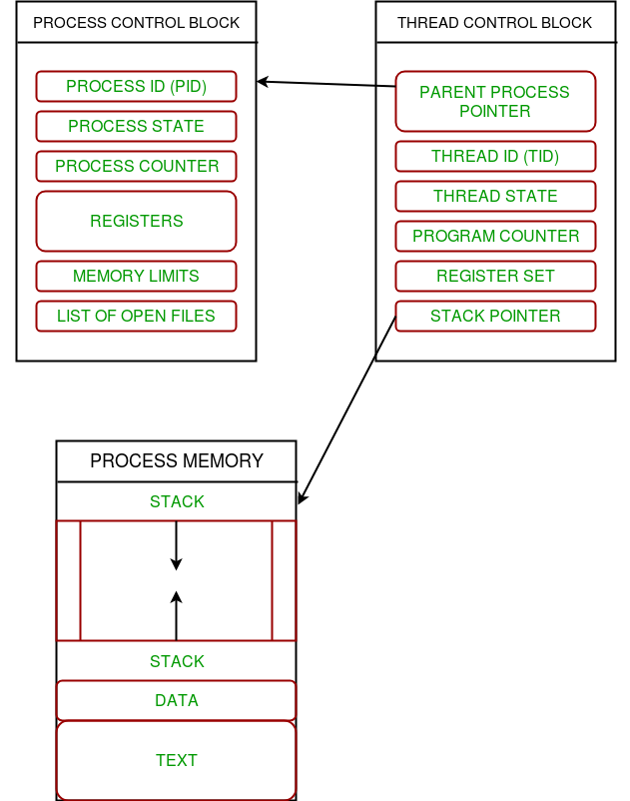

Slide 20
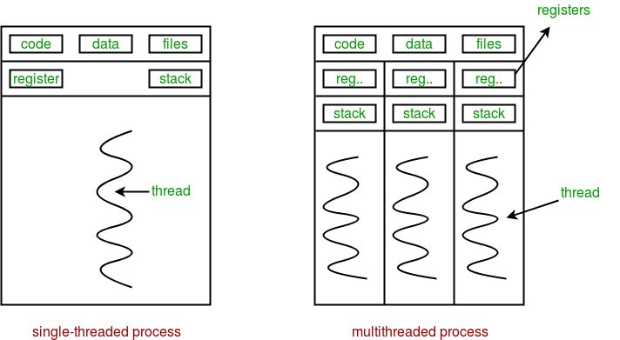
Multiple threads can exist within one process where:
Each thread contains its own register set and local variables (stored in stack).
All thread of a process share global variables (stored in heap) and the program code.
Consider the diagram below to understand how multiple threads exist in memory:

Slide 21
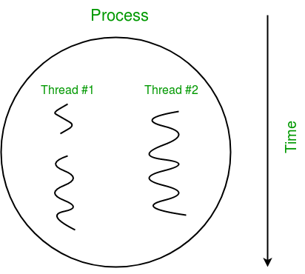
Multithreading is defined as the ability of a processor to execute multiple threads concurrently.
In a simple, single-core CPU, it is achieved using frequent switching between threads. This is termed as context switching. In context switching, the state of a thread is saved and state of another thread is loaded whenever any interrupt (due to I/O or manually set) takes place. Context switching takes place so frequently that all the threads appear to be running parallely (this is termed as multitasking).
Consider the diagram below in which a process contains two active threads:

Slide 22
Let us consider a simple example using threading module:
#Python program to illustrate the concept of threading importing the threading module
import threading
def print_cube(num):
"""
function to print cube of given num
"""
print("Cube: {}".format(num * num * num))
def print_square(num):
"""
function to print square of given num
"""
print("Square: {}".format(num * num))
if __name__ == "__main__":
# creating thread
t1 = threading.Thread(target=print_square, args=(10,))
t2 = threading.Thread(target=print_cube, args=(10,))

Slide 23
# starting thread 1
t1.start()
# starting thread 2
t2.start()
# wait until thread 1 is completely executed
t1.join()
# wait until thread 2 is completely executed
t2.join()
# both threads completely executed
print("Done!")
Output
Square: 100
Cube: 1000
Done!

Slide 24
Let us try to understand the above code:
To import the threading module, we do:
import threading
To create a new thread, we create an object of Thread class.
It takes following arguments:
target: the function to be executed by thread
args: the arguments to be passed to the target function
In above example, we created 2 threads with different target functions:
t1 = threading.Thread(target=print_square, args=(10,))
t2 = threading.Thread(target=print_cube, args=(10,))
To start a thread, we use start method of Thread class.
t1.start()
t2.start()
Once the threads start, the current program (you can think of it like a main thread) also keeps on executing.
In order to stop execution of current program until a thread is complete, we use join method.
t1.join()
t2.join()

Slide 25
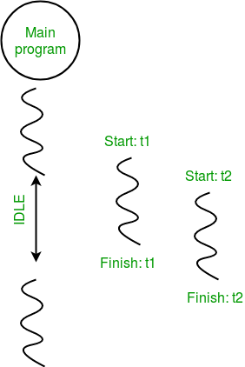
As a result, the current program will first wait for the completion of t1 and then t2. Once, they are finished, the remaining statements of current program are executed.
Consider the diagram below for a better understanding of how above program works:

Slide 26
Synchronizing threads
To deal with race conditions, deadlocks, and other thread-based issues, the threading module provides the Lock object.
The idea is that when a thread wants access to a specific resource, it acquires a lock for that resource.
Once a thread locks a particular resource, no other thread can access it until the lock is released.
As a result, the changes to the resource will be atomic, and race conditions will be averted.
A lock is a low-level synchronization primitive implemented by the __thread module. At any given time, a lock can be in one of 2 states: locked or unlocked.
It supports two methods:
acquire()
When the lock-state is unlocked, calling the acquire() method will change the state to locked and return. However, If the state is locked, the call to acquire() is blocked until the release() method is called by some other thread.
release()
The release() method is used to set the state to unlocked, i.e., to release a lock. It can be called by any thread, not necessarily the one that acquired the lock.

Slide 27
Here's an example of using locks in your apps. Fire up your IDLE and type the following:
import threading
lock = threading.Lock()
def first_function():
for i in range(5):
lock.acquire()
print ('lock acquired')
print ('Executing the first funcion')
lock.release()
def second_function():
for i in range(5):
lock.acquire()
print ('lock acquired')
print ('Executing the second funcion')
lock.release()
if __name__=="__main__":
thread_one = threading.Thread(target=first_function)
thread_two = threading.Thread(target=second_function)

Slide 28
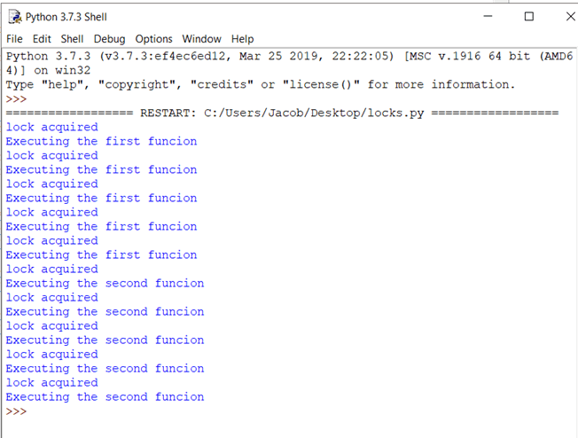
thread_one.start()
thread_two.start()
thread_one.join()
thread_two.join()
Now, hit F5.
You should see
an output like this:

